Slide 1

Shadow removal for forest ground images
SCC5830 – Image Processing
Luiz Alberto Hiroshi Horita – nº USP 6882704
Msc. Candidate

Slide 2
Motivation and objective
In real life application, one of the main causes of environment noise is shadow, which distort both image intensity (luminance) and color (chrominance).
This work aims to remove the shaows from a scene of eucalyptus forest, so the objects on it become clearer for segmentation

Slide 3
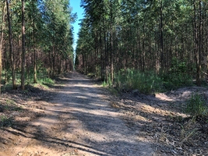
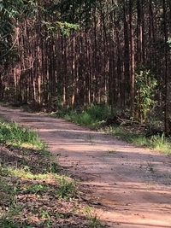
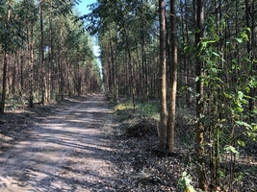
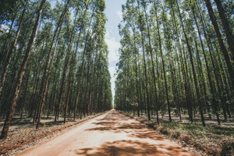
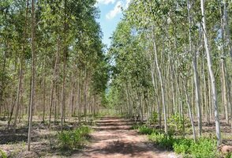
Motivation and objective

Slide 4
Methodes
1. Shadow detection
1.1. Color spaces analysis
1.2. Separating lit, penumbra and umbra regions
1.3. Filtering noise
2. Subgroups clustering based on colors
3. Removing shadows with local histogram enhancement

Slide 5
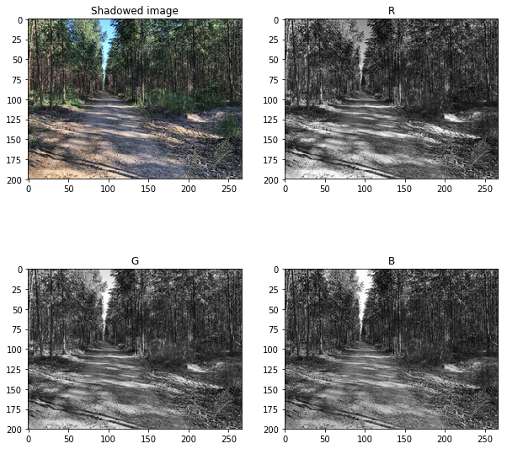
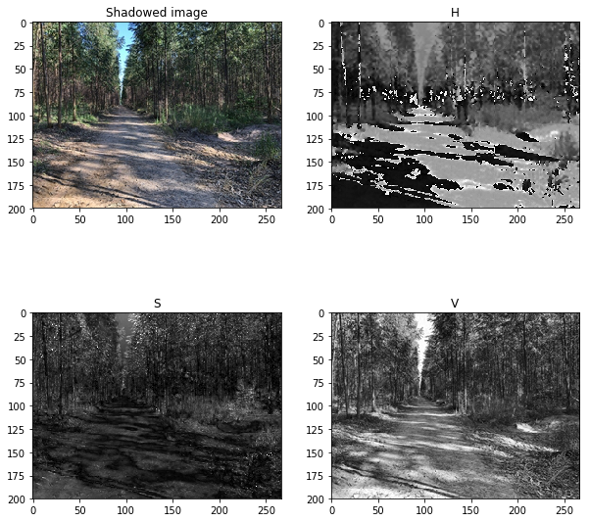
1. Shadow detection
Luminance
$$luminance=0.299 ∙R+0.587∙G+0.114∙B$$

Slide 6
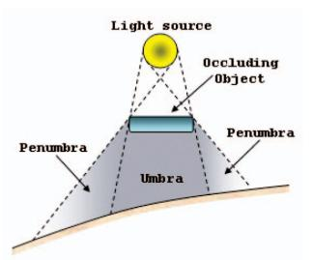
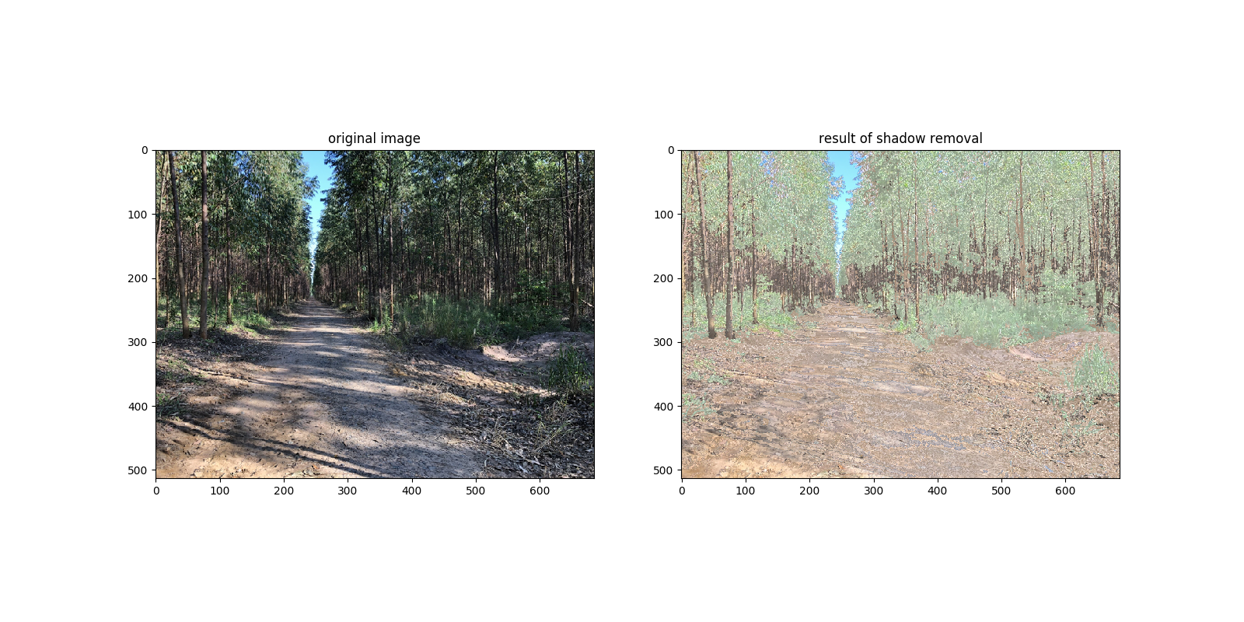
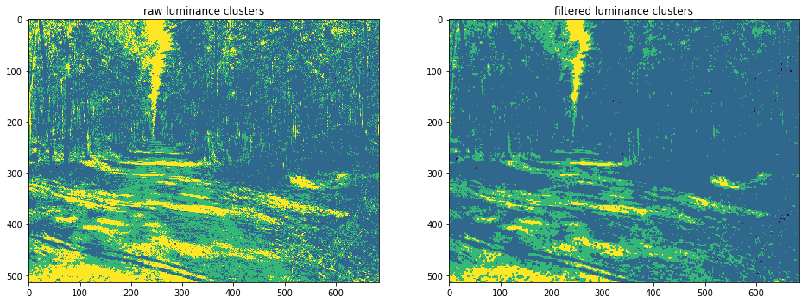
1. Shadow detection
Filtering the result of luminance clustering using adaptive filter.

Slide 7
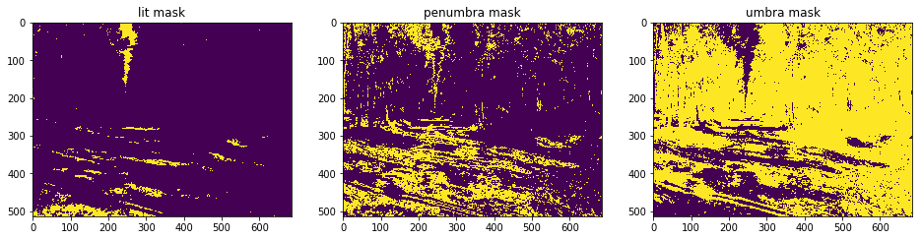
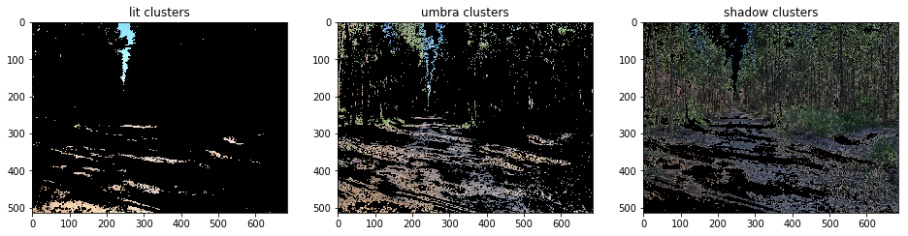
1. Shadow detection

Slide 8
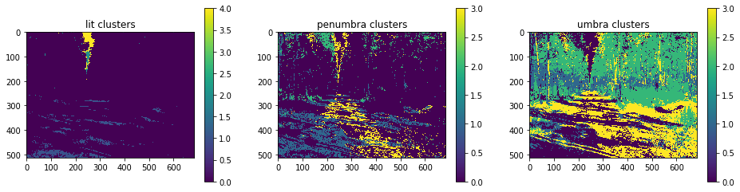
2. Subgroups clustering based on colors

Slide 9
3. Removing shadow

Slide 10
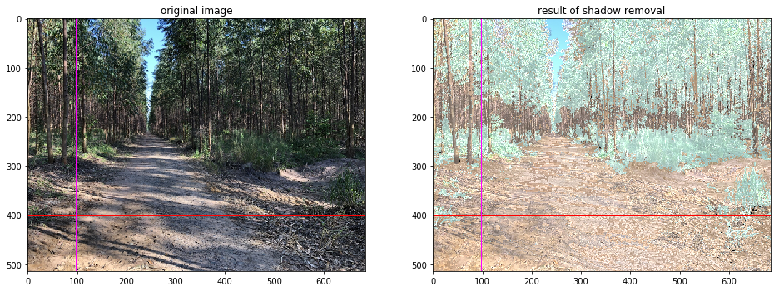
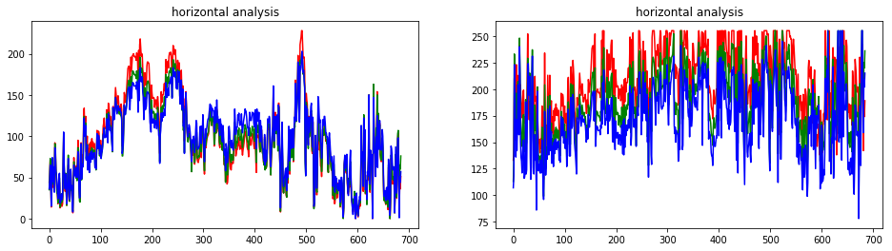
Results and discussion

Slide 11
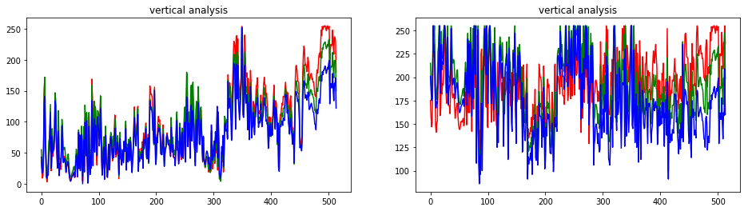
Results and discussion

Slide 12
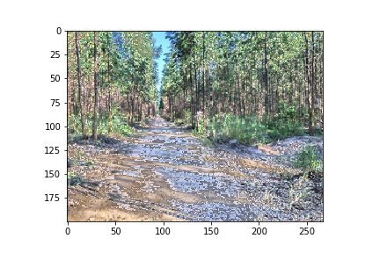
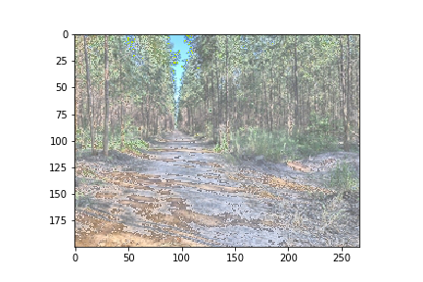
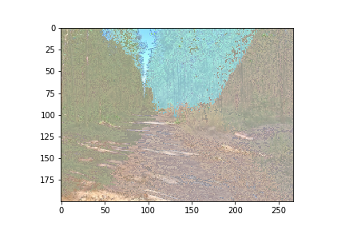
Failures
1st. Try
Histogram equalization on detected shadow region.
2nd. Try
Histogram equalization on detected shadow regions based on lit region.
3rd. Try
Histogram equalization based on each region’s shadow and lit area.

Slide 13
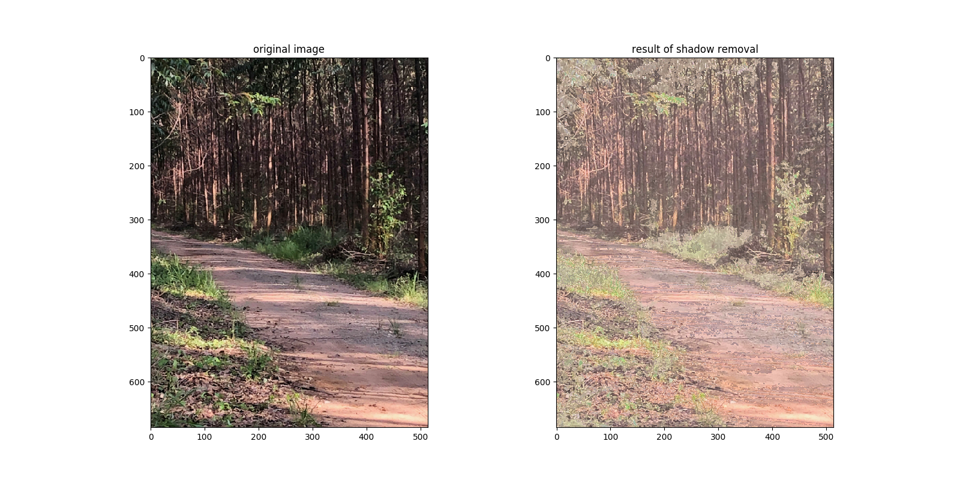
Algorithm applied on unseen scenes
Unseen image 1
Image captured by the same camera used to capture the image used on this work development.

Slide 14
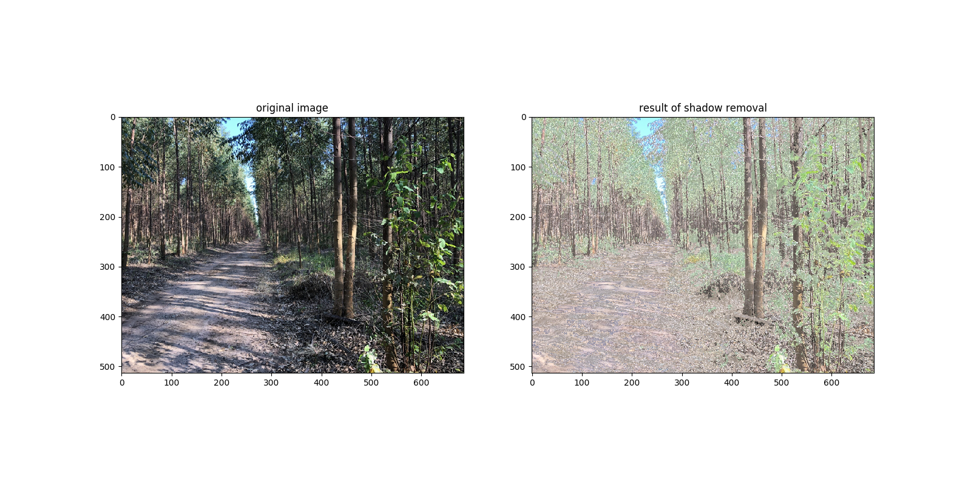
Algorithm applied on unseen scenes
Unseen image 2
Image captured by the same camera used to capture the image used on this work development.

Slide 15
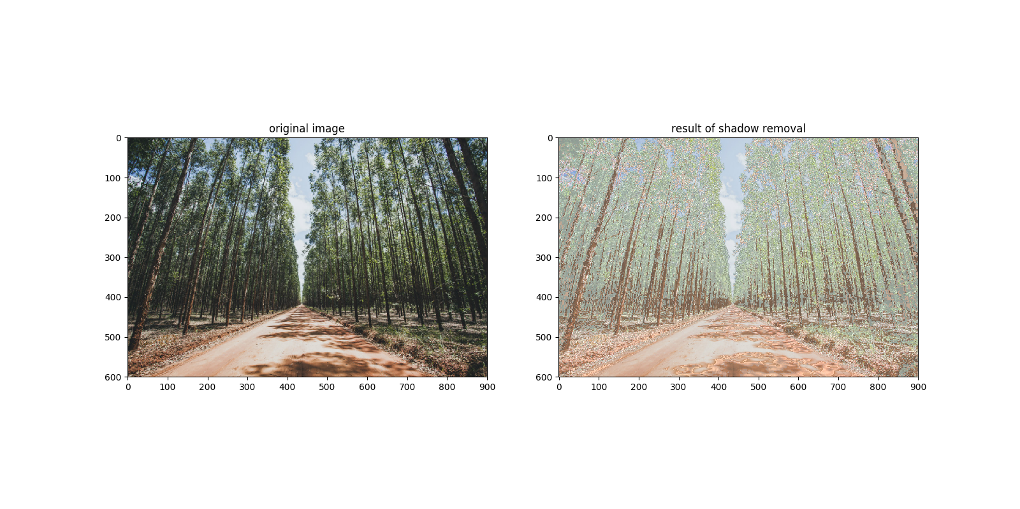
Algorithm applied on unseen scenes
Unseen image 3
Image captured by the different camera used to capture the image used on this work development.

Slide 16
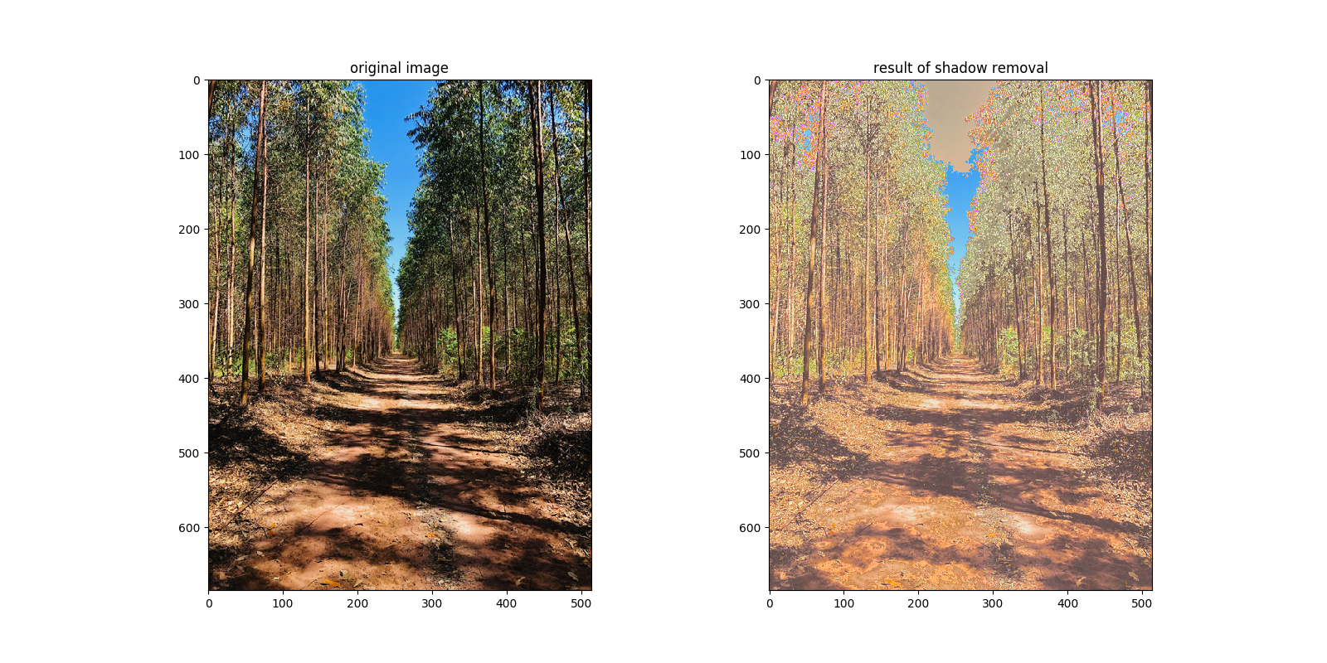
4.2. Algorithm applied on unseen scenes
Unseen image 4
Image captured by the different camera used to capture the image used on this work development.

Slide 17
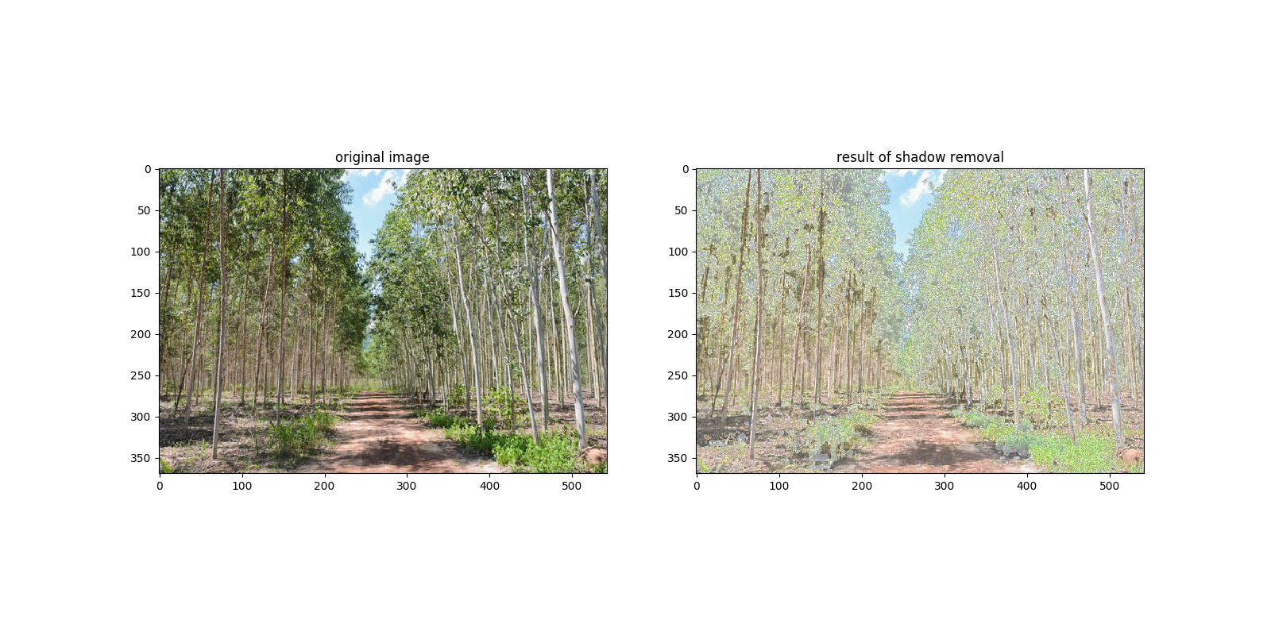
Algorithm applied on unseen scenes
Unseen image 5
Image captured by the different camera used to capture the image used on this work development.

Slide 18
Conclusion
Complex scenario;
The shadow removal was not perfect;
For segmentation of road (navigable area) had good results;
Limitations:
Works only for same kind of scenario;
Works only for images captured from same câmera;
It takes long time to execute.

Slide 19
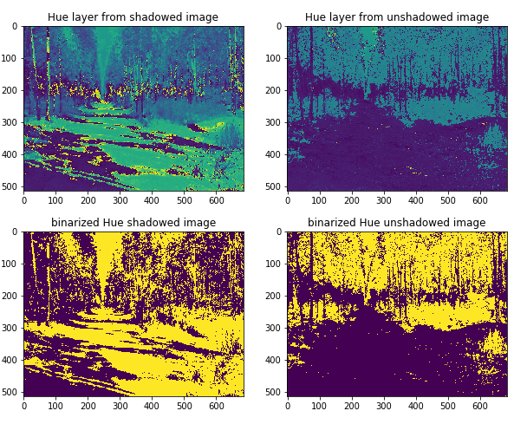
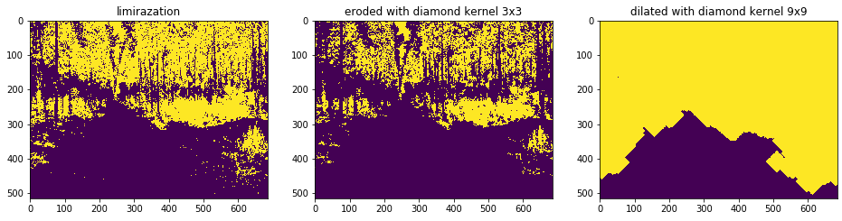
Conclusion
Comparing road detection before and after shadow removal.

Slide 20

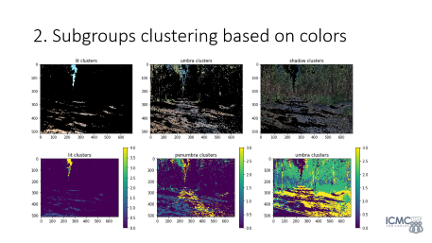
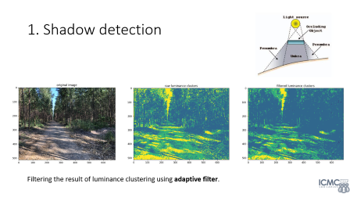
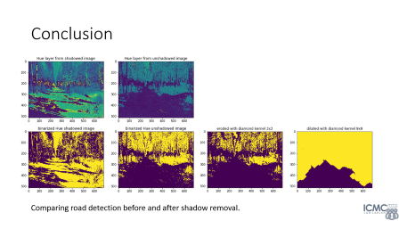
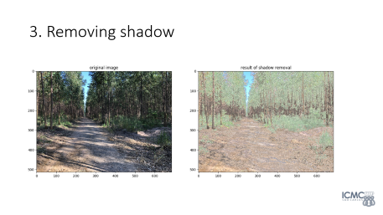
Thank you!
Any question?

